Slide 1

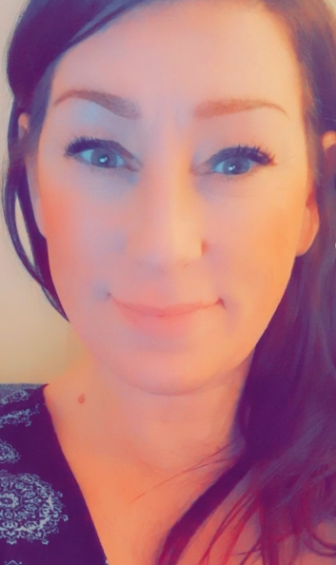
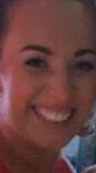
English at Britannia Bridge
Subject Leader: Mrs Carol Pidgeon-Duncalf/Mrs Kathryn Bold
Our Strengths Our Next Steps
At KS2, until 2019, the improving trend in writing, over the last four years, has culminated in the percentage of our children meeting the expected standard being higher than the national average. Despite the Pandemic (and extremely low starting points) our Y6 children achieved in line with their peers, nationally, in 2022.
To ensure that each and every one of our children develop, rapidly, as early readers and they achieve sound phonological awareness/ability.
To ensure all our children (including higher attainers) progress, rapidly, to develop their reading comprehension skills, linked to the Content Domains
At KS2, between 2016 and 2019, we have seen an improving trend in reading, grammar and spelling attainment, with results above the national average.
Between 2016 and 2019, we have seen an improving trend in the number of our EY children achieving a Good Level of Development.

Slide 2
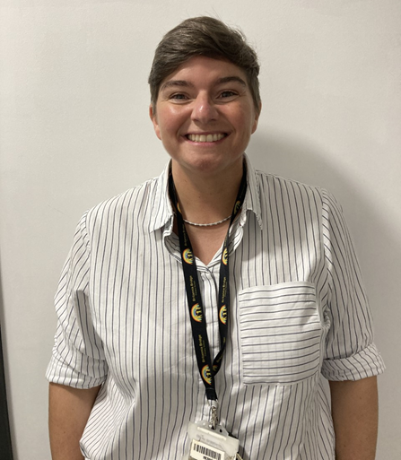
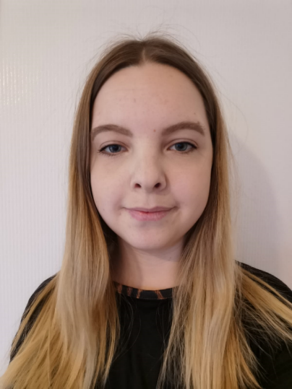
Mathematics at Britannia Bridge
Subject Leader: Miss Caroline Hooper/Mrs Laura Greenhalgh
Our Strengths Our Next Steps
We have developed our children’s love
of mathematics.
To ensure that more of our children become Greater Depth Mathematicians.
We have improved our children’s mathematical fluency,
especially times tables skills.
We have raised the profile of maths and attainment, across school.

Slide 3
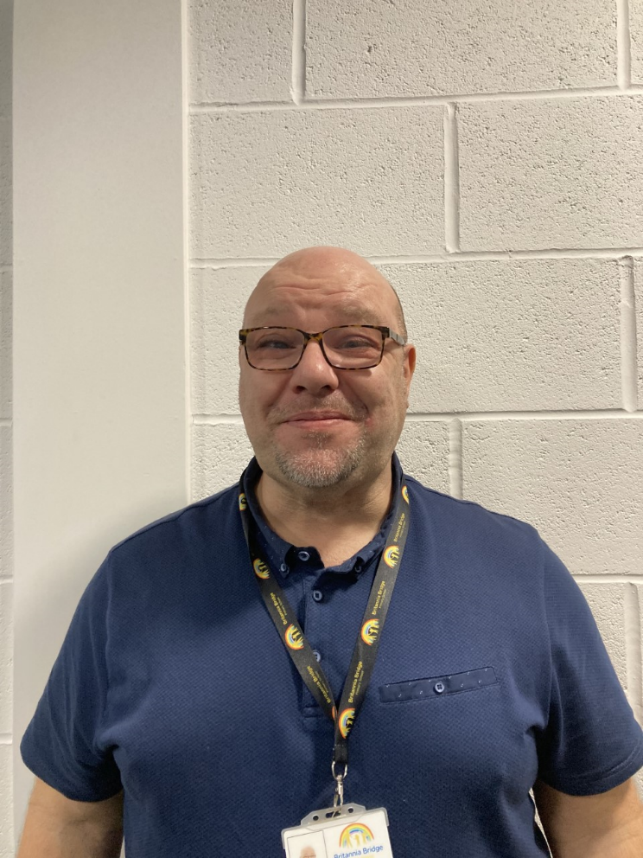
Physical Education at Britannia Bridge
Subject Leader: Mr Anthony Concannon
Our Strengths Our Next Steps
We have improved our progressive PE curriculum and assessment process to ensure we have a clear picture of our children’s progress and attainment, across school.
To ensure that our PE Curriculum is progressive, from N2 to Y6.
We have enhanced our teachers’ subject knowledge, though Continuous Professional Development.
We have raised the levels of participation in competitive sports for our children.

Slide 4
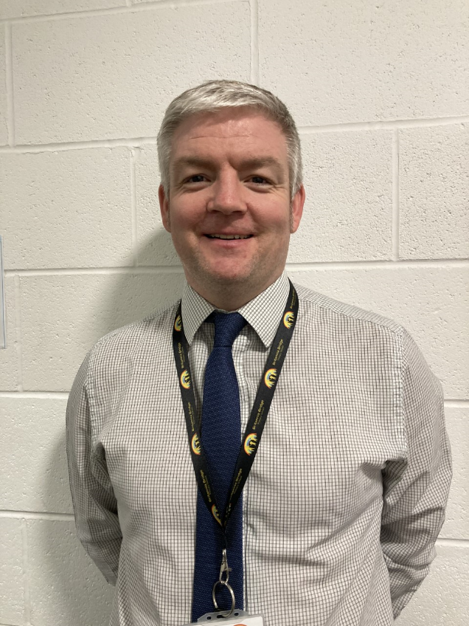
Geography at Britannia Bridge
Subject Leader: Mr Jonathon Alty
Our Strengths Our Next Steps
We have a clear, bespoke Intent statement, which underpins our progressive, geography curriculum.
To offer our children an even greater range of fieldwork opportunities and to ensure progression, from N2 to Y6.
We have improved the quality of our geography curriculum to ensure our children build on prior learning, can do more and remember more, retain essential knowledge and skills, ready for KS3 and beyond.
We have improved our children’s map work skills - including using digital maps and scales to follow routes. Our children are better at recognising a range of physical and human features.

Slide 5
History at Britannia Bridge
Subject Leader: Mrs Kathryn Bold
Our Strengths Our Next Steps
We have a clear, bespoke Intent statement, which underpins our progressive, history curriculum.
We have improved the quality of our curriculum to ensure our children build on prior learning, can do more and remember more, retain essential knowledge and skills, ready for KS3 and beyond.
To ensure that our history curriculum is progressive, from Nursery 2 to Y6.
Our children thoroughly love their history learning and are self-motivated learners.

Slide 6
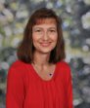
French at Britannia Bridge
Subject Leader: Miss Megan Lewis
Our Strengths Our Next Steps
Our children are more confident French speakers.
To ensure that each and every one of our children leaves us knowing more and able to do more, ready for KS3 and beyond (with essential knowledge and skills retained in their long-term memory).
We have developed a progressive and supportive curriculum, for our non-specialist French teachers, with built in Continuous Professional Development.
We celebrate the culture of France and other cultures of our children in school.

Slide 7
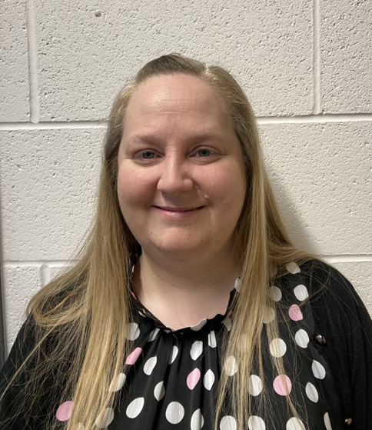
Phonics at Britannia Bridge
Subject Leader: Miss Megan Lewis
Our Strengths Our Next Steps
We deliver daily, high-quality, systemtatic phonics teaching, to ensure our children develop, rapidly, as early readers.
To ensure that our children continue to make rapid progress, develop their phonological awareness and early reading skills.
Our staff are expertly trained, in phonics, which enables our children to progress so well.
We involve our families as partners in their child’s phonics learning.

Slide 8

PSHE at Britannia Bridge
Subject Leader: Miss Laura Tuner
Our Strengths Our Next Steps
We have designed a child-friendly, well rounded, bespoke PSHE curriculum.
To continue to improve our assessment techniques for PSHE.
Our curriculum has clear progression, throughout the year groups, and builds on our children’s prior learning.
Money management and enterprise topics allow our children to develop their understanding of budgeting and careers.

Slide 9
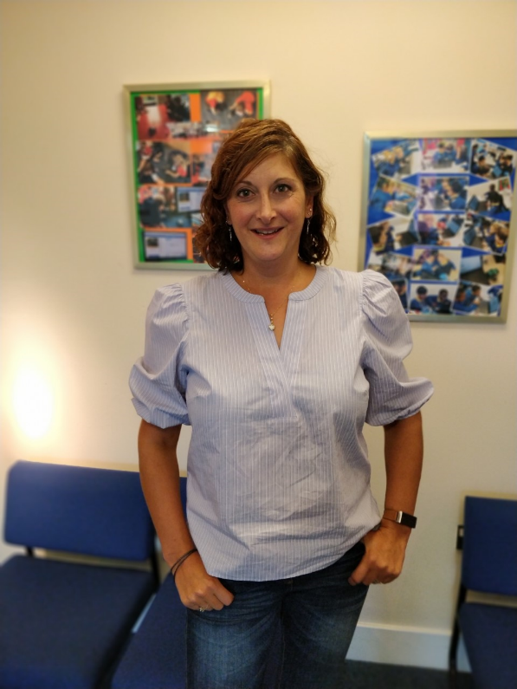
Computing at Britannia Bridge
Subject Leader: Mrs Maria Temel
Our Strengths Our Next Steps
Staff feel well trained and confident in delivering the computing curriculum for our children.
To continue to raise our children’s aspirations about their future prospects in STEM subjects.
Our curriculum is geared to giving our children a vast array of exciting and memorable experiences, to ensure sticky learning of essential knowledge and skills.
Our children thoroughly enjoy their computing lessons and are self-motivated learners.

Slide 10
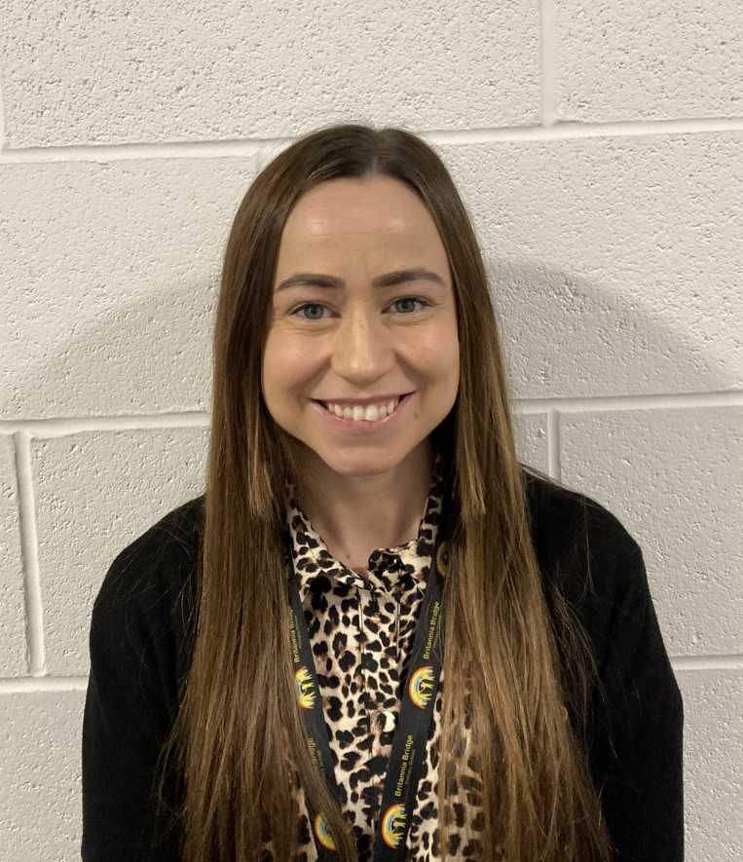
Art and Design at Britannia Bridge
Subject Leader: Miss Melissa Burke
Our Strengths Our Next Steps
Our curriculum ensures a continuous progression of art skills and incorporates Continuous Professional Development opportunities for our non-specialist staff.
To ensure that our Art curriculum is progressive from N2 to Year 6.
Our children use a wide range of media, materials and techniques to express themselves.
Our influences in Art come from a diverse number of Artists from different backgrounds.

Slide 11
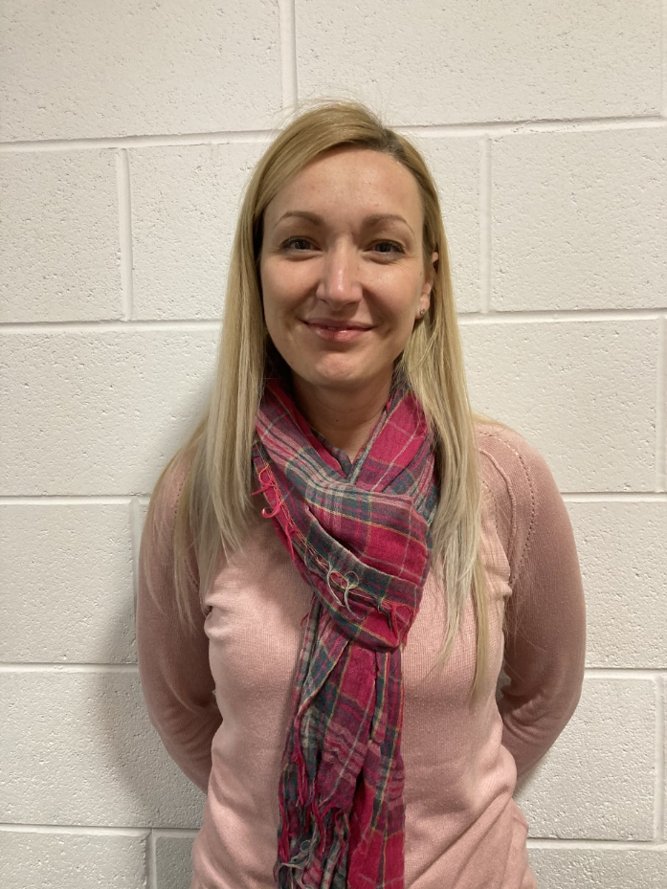
Design and Technology at Britannia Bridge
Subject Leader: Mrs Karen Williams
Our Strengths Our Next Steps
We have made links with Deans Trust Rose Bridge to deliver enrichment activities to support our Year 5 and 6 children.
To ensure that outcomes in DT are always high quality and our DT Curriculum is progressive from N2 to Y6.
We have developed our in-house, after school Cooking Club to explore healthy eating, hygiene, safe food preparation and various cooking techniques.
We have progressive, engaging and purposeful activities, with resources to support practical 'sticky knowledge' learning.

Slide 12
Religious Education at Britannia Bridge
Subject Leader: Mr Anthony Concannon
Our Strengths Our Next Steps
We have adapted the Wigan Schools Agreed Syllabus to ensure that we have an appropriate balance between exploring Christian beliefs and other faiths. We have ensured that it is bespoke and there is clear progression from N2 to Y6.
To bring our RE curriculum to life, for our children, through even more visits and visitors, linked to different faiths.
We have designed and implemented a new whole school approach to Collective Worship, which is progressive from N2 to Y6.
Our children remember more and can do more, ready for their learning at KS3 and beyond. Their retention of essential knowledge and skills is improving all the time and they possess a true respect for difference and diversity.

Slide 13
Our Community at Britannia Bridge
Subject Leader: Mr Anthony Concannon
Our strengths Our next steps
Our community lies at the HEART of everything we do at Britannia Bridge Primary School.
To encourage more parents/carers to become involved with Friends of Britannia Bridge to help plan, carry out and oversee the fundraising for our school.
Friends of Britannia Bridge is our very own Charity. We arrange, promote and oversee the extra-curricular fundraising for our school, which benefits all our children.
Our community football team, F.C. Britannia, provides the opportunity for all our children to play football and links us with the wider community.

Slide 14
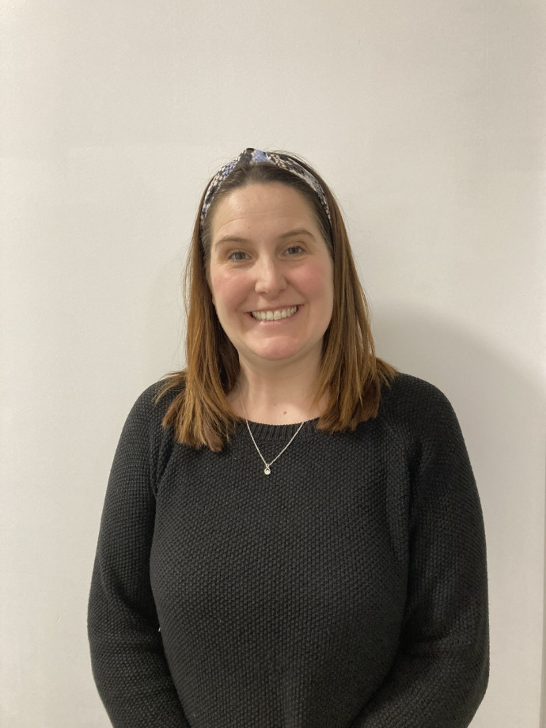
Science at Britannia Bridge
Subject Leader: Mrs Hayley Federici
Our Strengths Our Next Steps
There is now a greater emphasis on practical investigations and our children’s investigation skills.
To gain the Primary Science Quality Mark for our school to ensure our provision is the best that it can be for our children.
We have a robust tracking and assessment system to identify our children’s next steps in science.
There is a now a higher percentage of our children, who are achieving Age Related Expectations in science.

Slide 15
Music at Britannia Bridge
Subject Leader: Ms Lindsay McKinney
Our Strengths Our Next Steps
We work closely with outside agencies to provide our children with specialist music teaching and 1:1 tuition.
To further improve our assessment process to ensure that we have a clear picture of our children’s progress and attainment, across school.
We give our children opportunities to showcase their talents. They take part in many community events, such as singing in performances, concerts and shows to develop their musical skills and their social and cultural values.
The KAPOW Music Scheme provides all our children with fun and challenging learning experiences. It is progressive, from N2 to Y6, and incorporates integral Continued Professional Development opportunities for our non-specialist staff.

